Slide 1
Forecasting Atmospheric Turbulence Conditions from Prior Environmental Parameters Using Artificial Neural Networks: An Ensemble Study
Mitchell Grose
Advisor: Dr. Edward A. Watson
19 April 2021
Notes:
Title slide with: thesis title, my name, advisor name, date of defense

Slide 2
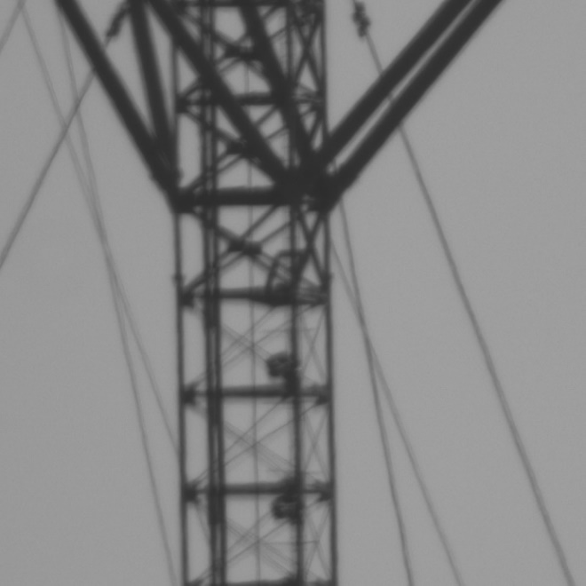
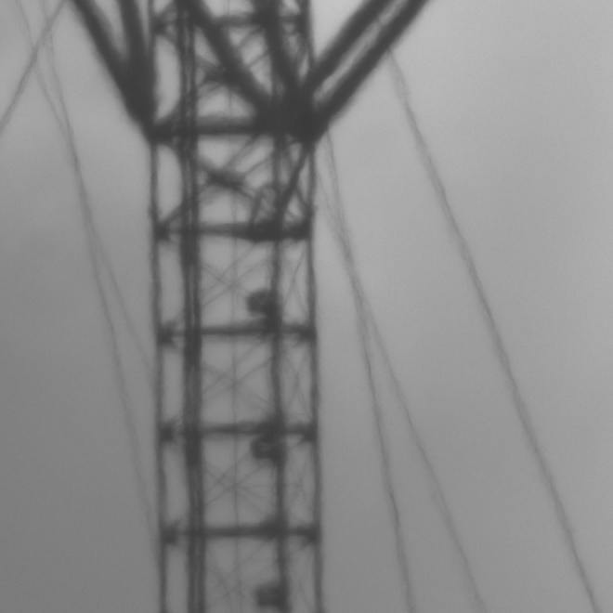

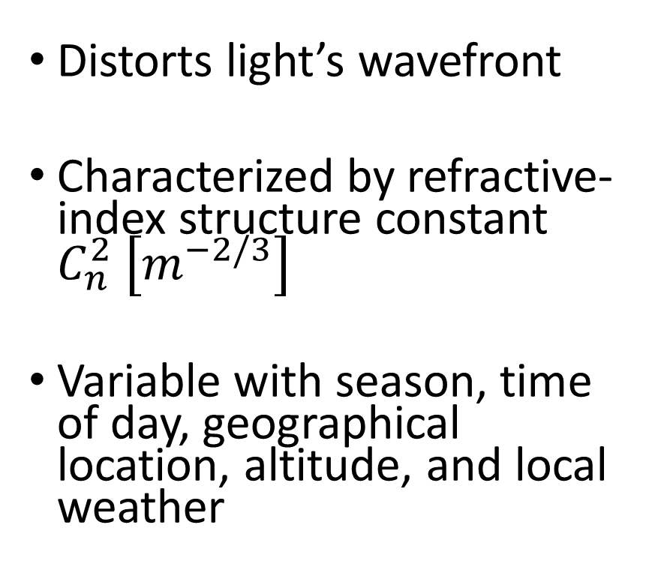
What is Turbulence $\left(C_{n}^{2}\right)$?
Distorts light’s wavefront
Characterized by refractive-index structure constant $C_{n}^{2} \left[m^{−2/3}\right]$
Variable with season, time of day, geographical location, altitude, and local weather
Weak
Strong
Notes:
Introduce the concept of turbulence: it distorts light’s wavefront, is characterized by Cn2, and is highly variable with season, time of day, geographical location, altitude, and local weather. Reference strong and weak turbulence using the images.

Slide 3
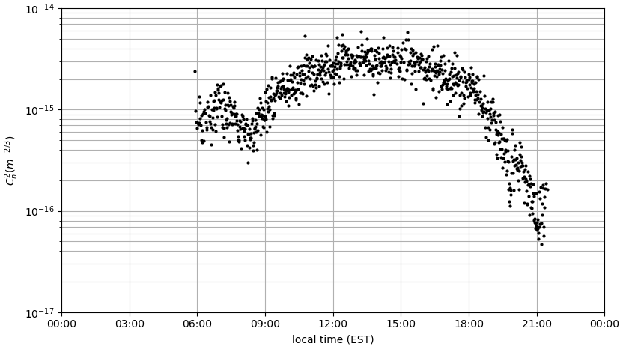
Turbulence Measurement and Modeling
Measure turbulence because it negatively impacts imaging and laser propagation systems
Modeling allows prediction of turbulence strength if a sensor is unavailable
Physics-based models do not capture the many cases
Notes:
Explain why it’s useful to measure and model turbulence. Discuss how physics-based models have been developed but do not capture the many cases. Mention Hufnagel-Valley as an example physical model that models turbulence with altitude.

Slide 4
Artificial Neural Networks
Machine learning has been proposed as a surrogate model
Improves automatically from examples without being explicitly programmed
Artificial Neural Networks are connection systems inspired by biological neural networks
Node or “Neuron”
Connection
Notes:
Introduce that machine learning models have been developed as surrogates. ANNs are a type of machine learning inspired by the brain

Slide 5
Machine Learning for Turbulence
Machine learning models relate local weather parameters with turbulence strength
From weather at a specific time the models predict turbulence strength at that time
More useful to forecast future turbulence conditions
Requires the download of numerical weather prediction data
Notes:
In the case of turbulence modeling, machine learning relates local weather conditions at time t with turbulence at time t. Discuss how it’s more useful to forecast future turbulence conditions (like how it’s more useful to know when it is going to rain rather than knowing it’s raining right now). Introduce the idea of forecasting future turbulence conditions and how it requires NWP data and introduces weather forecast errors.

Slide 6
Problem Statement
This thesis develops a machine learning approach to forecast four hours of future turbulence conditions at 30-minute intervals from prior weather and turbulence measurements using artificial neural networks
This method bypasses the need for physical model NWP weather forecasts
Notes:
Let the audience read my problem statement, then I describe it. This bypasses the need to download and format NWP data.

Slide 7
Thesis Overview
Machine Learning Review
Dataset
Grid Search
Model Evaluation
Work is done in Python
Machine learning library is PyTorch
Notes:
Outline topics covered in these slides. By the end of this presentation the audience will know that machine learning can be used to forecast future turbulence conditions from prior measurements.

Slide 8
Machine Learning Review

Slide 9
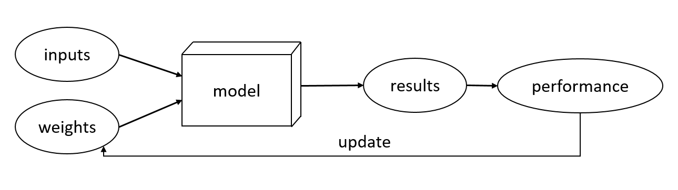
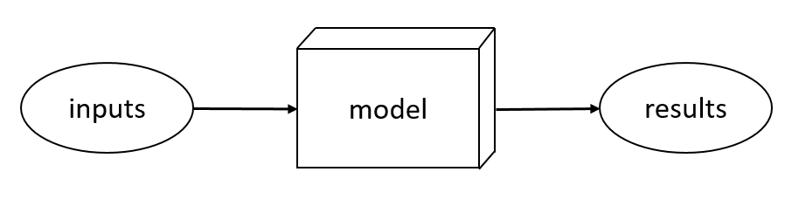
Simple Model Training and Testing
The model “trains” or “learns” by iteratively updating its parameters (weights) to improve performance
The model “tests” (performs inference) by applying the learned parameters to another set of inputs
Training
Testing
Notes:
Discuss the basics of machine learning modeling: training and testing

Slide 10
Model Architectures
Models are defined by their architecture
The architecture is the type of artificial neural network
The types of architectures investigated are the Multilayer Perceptron and Recurrent Neural Network
Notes:
Introduce that models are defined by their architectures, and that the MLP and RNN are investigated in this thesis.

Slide 11
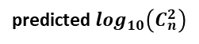
Multilayer Perceptron (MLP)
Example MLP in turbulence modeling
Fully-connected because each node in one layer connects with each node in the next layer with a weight
N-Node Hidden Layer
5-Node Input Layer
.
.
.
Temperature [K]
Pressure [Pa]
Relative Humidity [%]
predicted $\log_{10}\left(C_{n}^{2}\right)$
Wind Speed [m/s]
Solar Irradiance [W/m²]
.
.
.
Notes:
Introduce the MLP. Describe how it has an input layer, at least one hidden layer, and an output layer. Note that it’s a regression MLP because the output is continuous, not discrete. Describe how it’s fully connected because each node in one layer is fully connected to each node in the next layer with a weight. This specific example relates weather variables to a specific strength of turbulence.

Slide 12
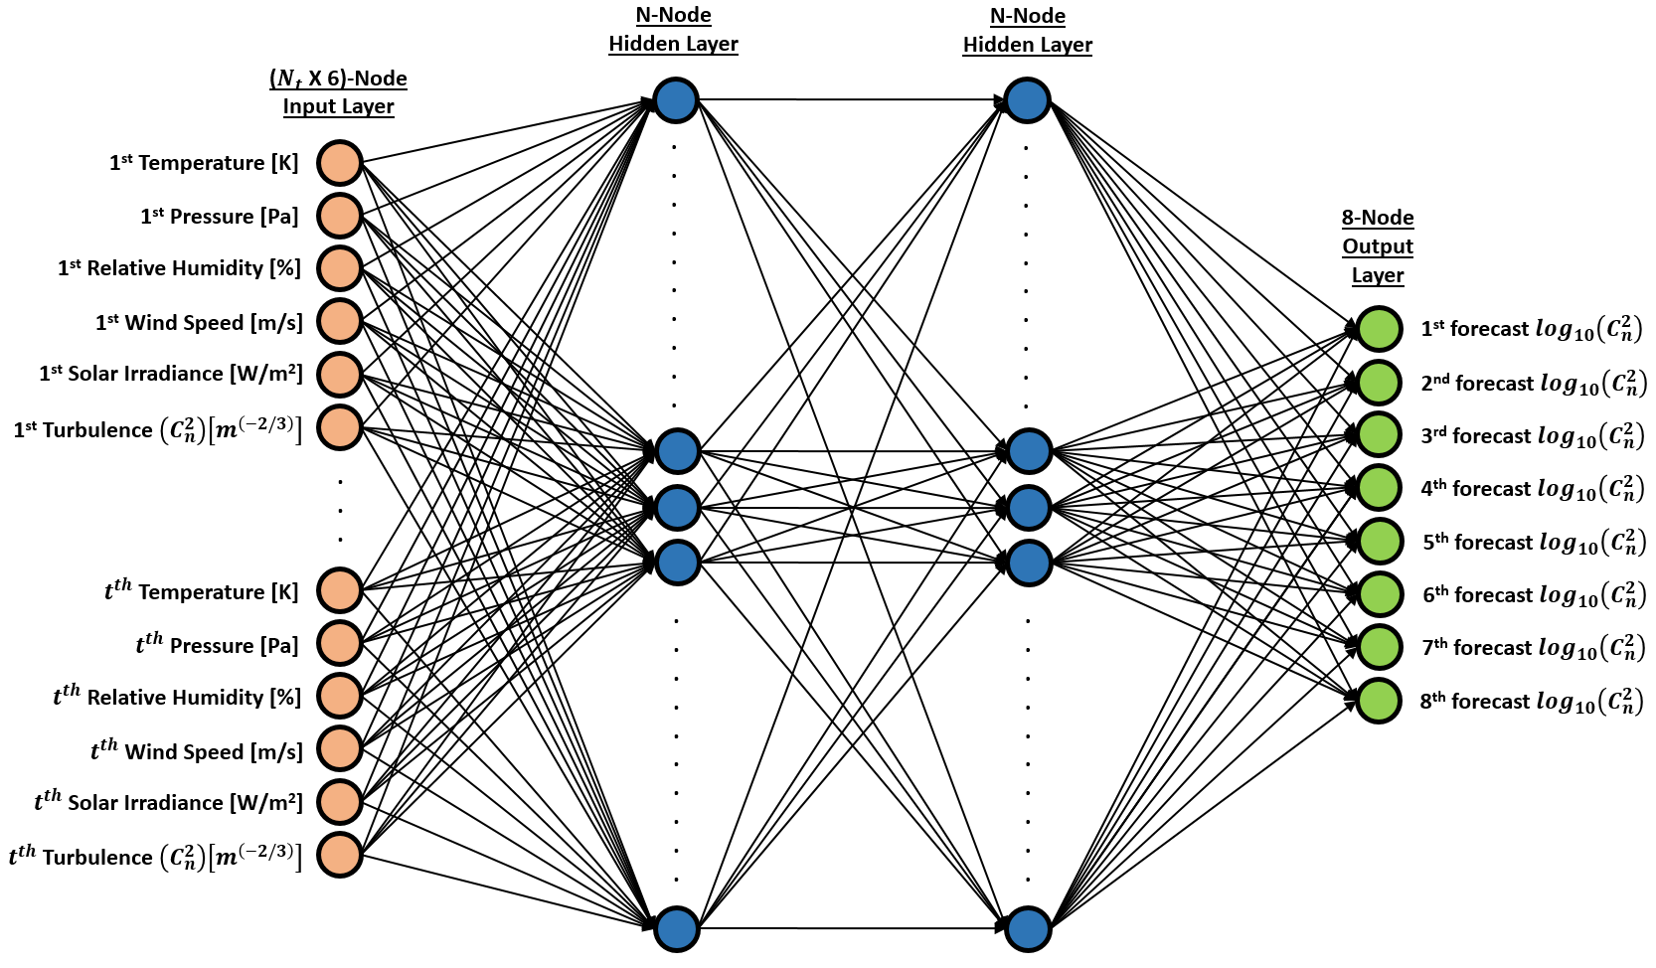
MLP for Turbulence Forecasting
Inputs are flattened into a single layer
Outputs are eight time steps of turbulence forecasts
Notes:
This is a 2-layer MLP architecture where the inputs are prior weather and turbulence measurements in a flattened array, and the outputs are eight time steps of turbulence. The inputs are *not* processed as a time series.

Slide 13
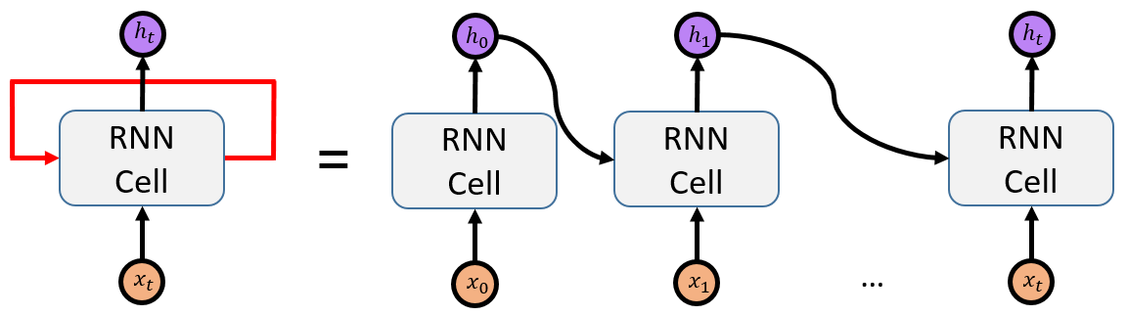
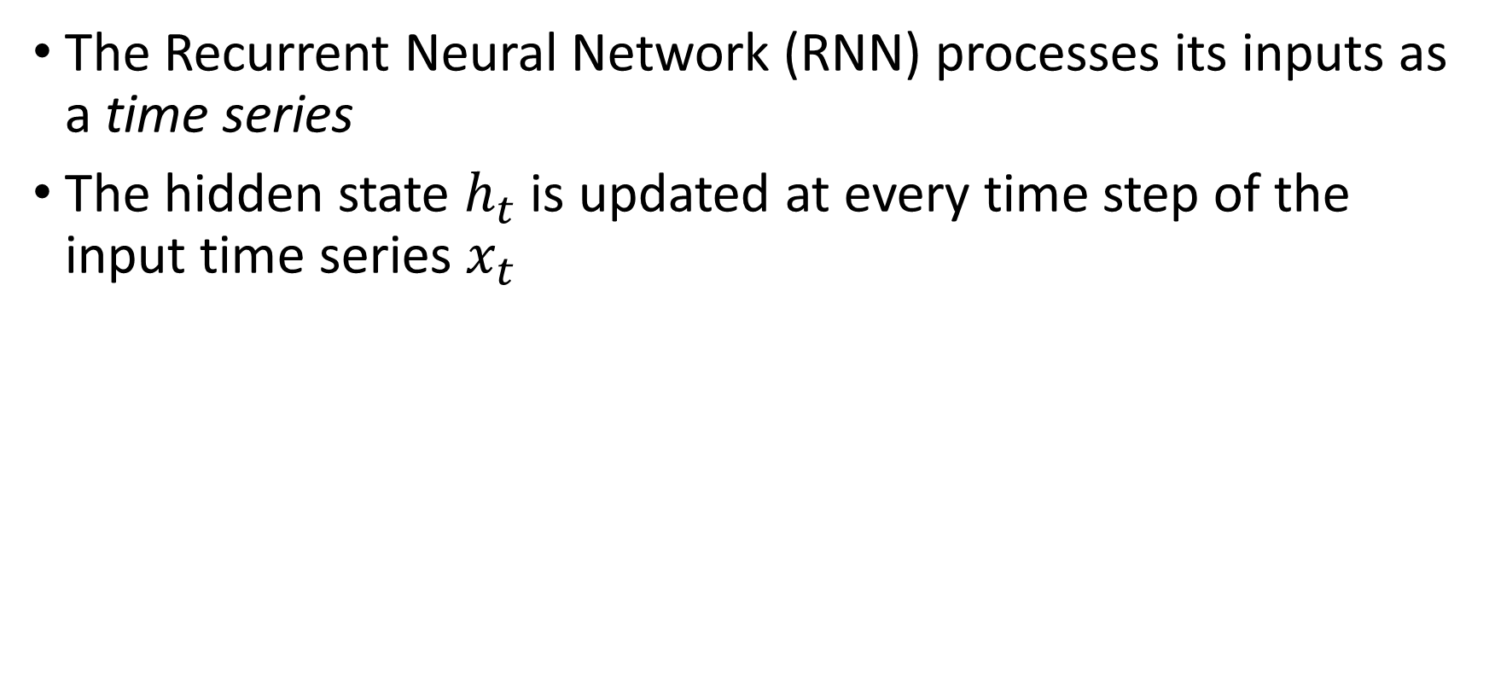
Recurrent Neural Network (RNN)
The Recurrent Neural Network (RNN) processes its inputs as a time series
The hidden state $h_{t}$ is updated at every time step of the input time series $x_{t}$
Notes:
Introduce the RNN. Note that the RNN processes its inputs as a time series by updating the hidden state h_t. The left side of the figure is the rolled (compact) version of the RNN processing. The right side is the unrolled version. Describe the processing in detail.

Slide 14
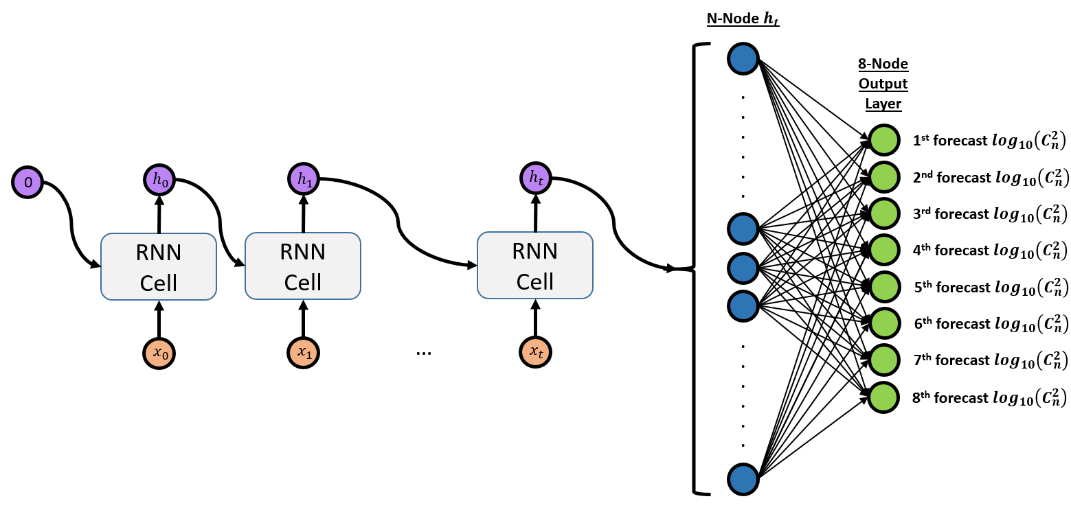
RNN for Turbulence Forecasting
Initial hidden state is zero
Inputs are processed as a time series
RNN Cell variants:
Simple RNN
Long Short-Term Memory (LSTM)
Gated Recurrent Unit (GRU)
Notes:
This is a single-layer RNN architecture. Be sure to note how the last hidden state h_{t} is fully-connected to the 8-node output layer of turbulence forecasts. Also note that the hidden state is initialized with all zeros.

Slide 15
Dataset

Slide 16
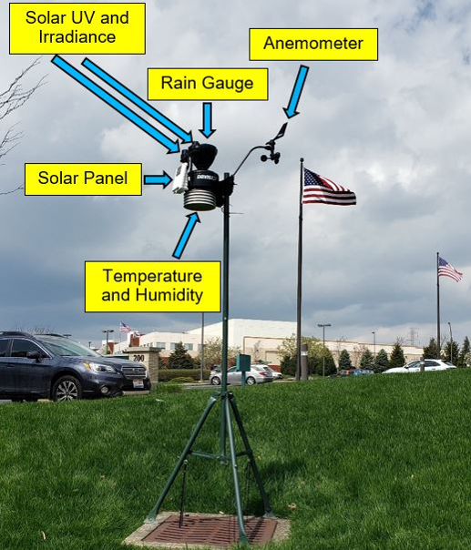
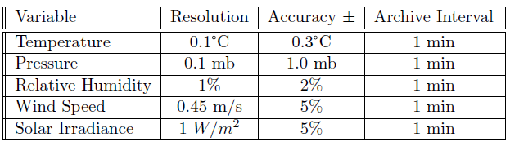
Weather Station
Weather measurements are from a Davis Instruments Vantage Pro2 Plus
Measurements are minute-by-minute 24 hours a day
10 April – 10 August 2020
Notes:
Discuss the weather station including that measurements are minute-by-minute and are made 24 hours a day. Also note that the station is located mostly in an open area, about 20-30 feet from an office building to the right of the image. Name the recorded variables used in this work.

Slide 17
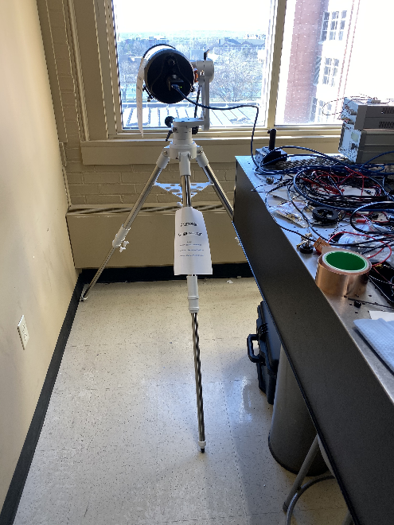
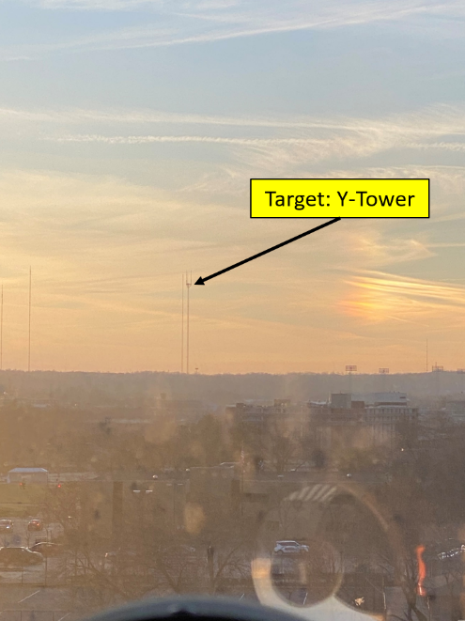
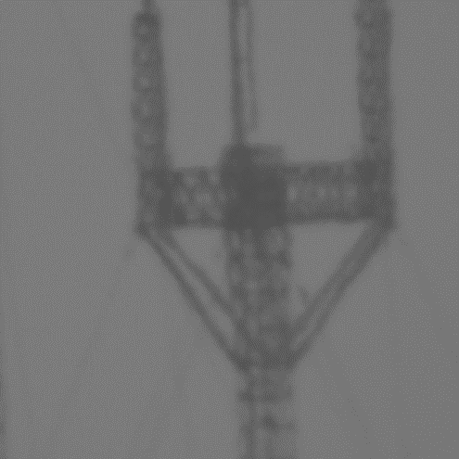

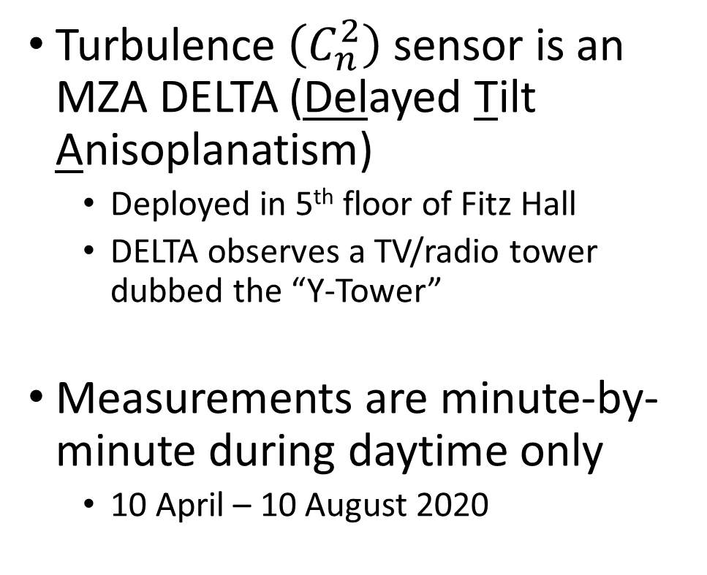
Turbulence Sensor
Turbulence $\left(C_{n}^{2}\right)$ sensor is an MZA DELTA (Delayed Tilt Anisoplanatism)
Deployed in 5th floor of Fitz Hall
DELTA observes a TV/radio tower dubbed the “Y-Tower”
Measurements are minute-by-minute during daytime only
10 April – 10 August 2020
Notes:
Introduce the DELTA and that it captures images of a target to measure the jitter of a variety of features across the image. Measurements are nighttime only!

Slide 18

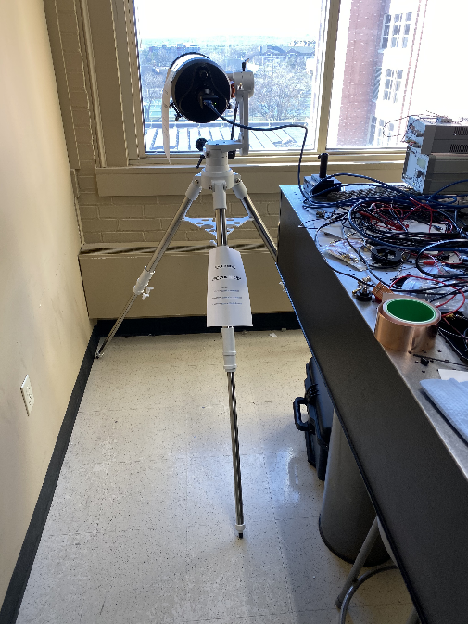
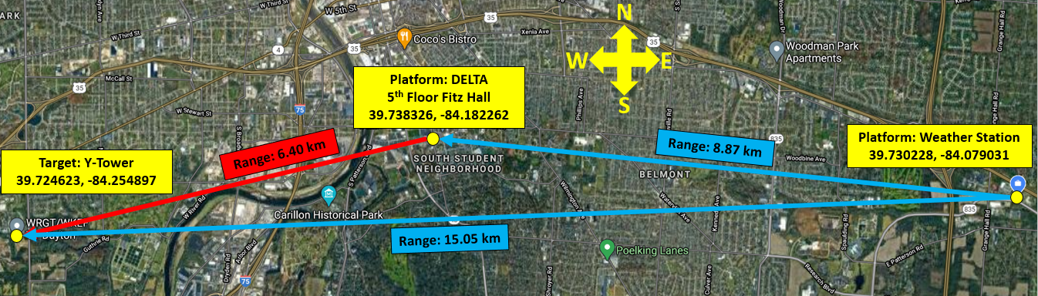
Geographical Setup
Notes:
Discuss the geographical setup. Weather measurements are 8.87km to the east of the DELTA platform and 15.05km to the east of the DELTA target (Y-Tower). The Y-Tower is 6.4km to the southwest of the DELTA platform. Make sure to discuss how this adds a significant level of complexity to the modeling: I’m asking the model to learn the relationship between weather and turbulence measurements that are geographically separated by a significant distance. Window-averaging as part of data preprocessing is expected to dampen the impact of the spatial separation.

Slide 19
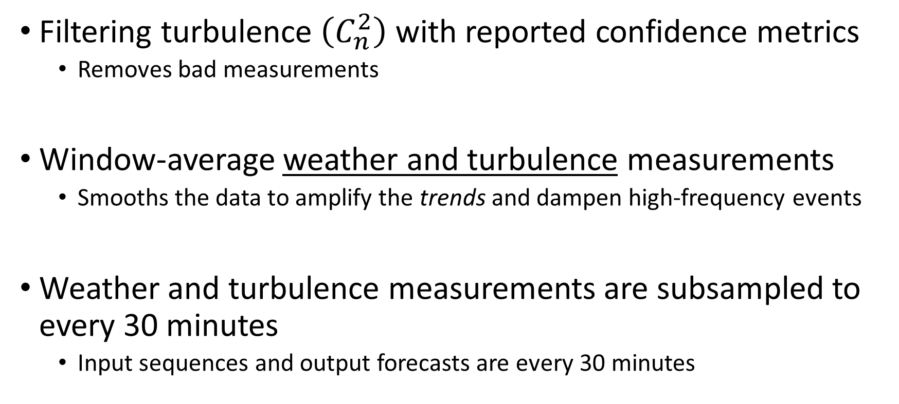
Data Preprocessing
Filtering turbulence $\left(C_{n}^{2}\right)$ with reported confidence metrics
Removes bad measurements
Window-average weather and turbulence measurements
Smooths the data to amplify the trends and dampen high-frequency events
Weather and turbulence measurements are subsampled to every 30 minutes
Input sequences and output forecasts are every 30 minutes
Notes:
Describe data preprocessing steps: first filter the turbulence data based on well developed metrics, then window-average both the weather and turbulence measurements to smooth them out, then subsample to every 30 minutes.

Slide 20
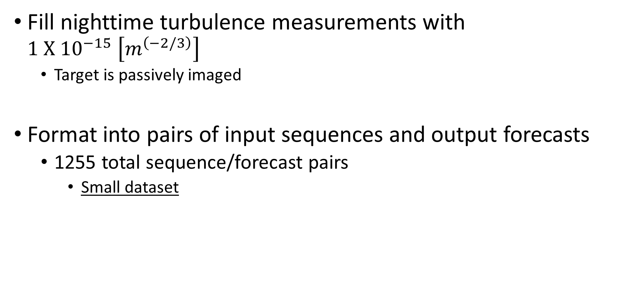
Data Preprocessing
Fill nighttime turbulence measurements with $1{ X 10}^{−15} \left[m^{\left(−2/3\right)}\right]$
Target is passively imaged
Format into pairs of input sequences and output forecasts
1255 total sequence/forecast pairs
Small dataset
Notes:
Continue describing preprocessing steps: fill nighttime measurements with a constant Cn2 because not doing this causes the loss of morning forecasts, and then only shorter sequences are available. Format into pairs of input sequences and output forecasts with inputs of 4 hours, 8 hours, 12 hours, and 16 hours. Only the common sequence/forecast pairs are kept. Parse into train / validation / test sets: describe the purpose of each, and that I chose the dates based on 1-2 months of deployment and the weather conditions during these times are stable.

Slide 21
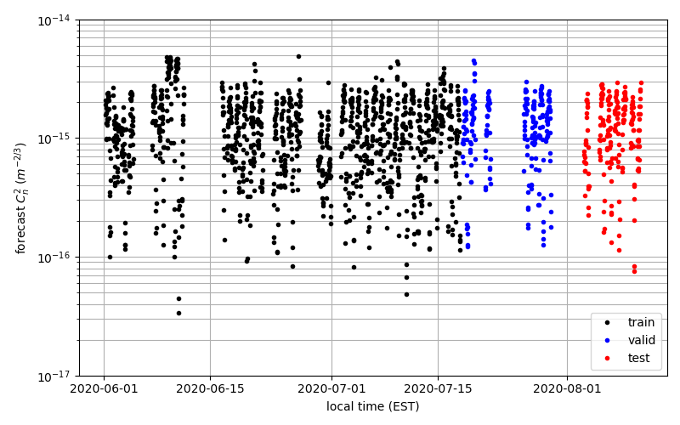
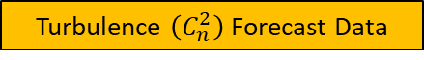
Parse into Train / Validation / Test Datasets
Parse into train, validation, and test datasets
Train: data for training models in the grid search
Validation: data for evaluating model performance in grid search
Test: data for final model evaluation
Train: 01 June – 17 July
Validation: 18 July – 01 August
Test: 02 August – 10 August
Turbulence $\left(C_{n}^{2}\right)$ Forecast Data

Slide 22
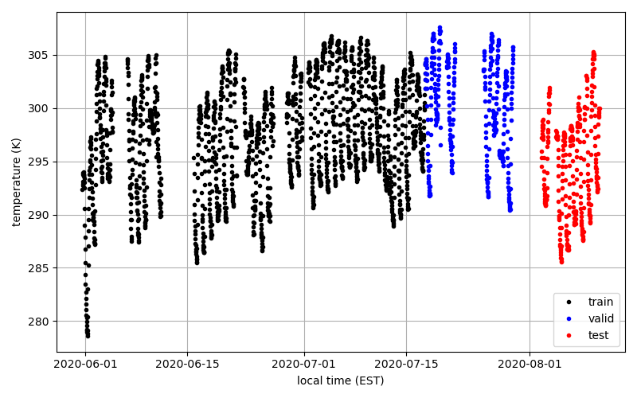
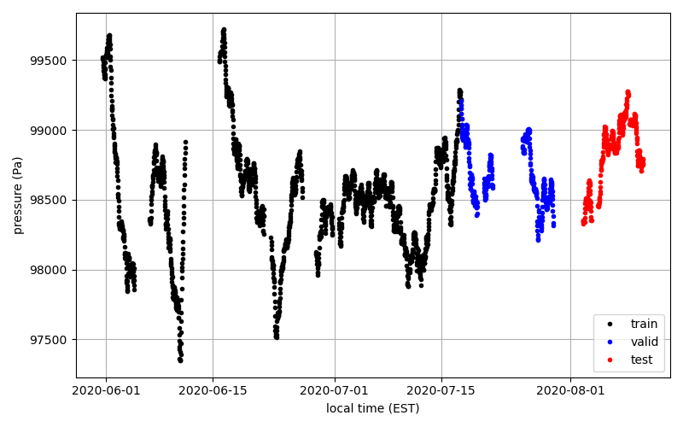
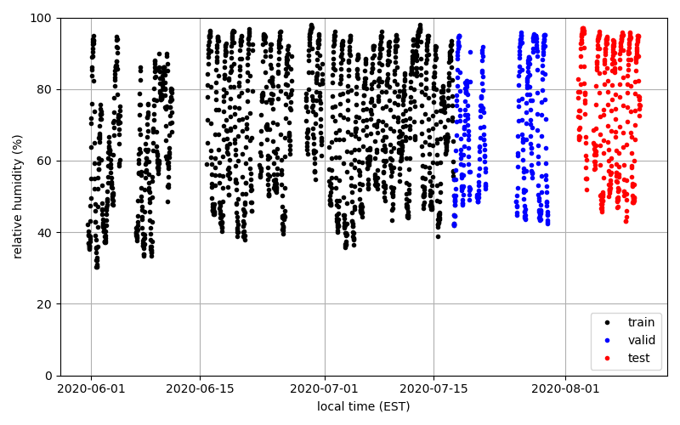
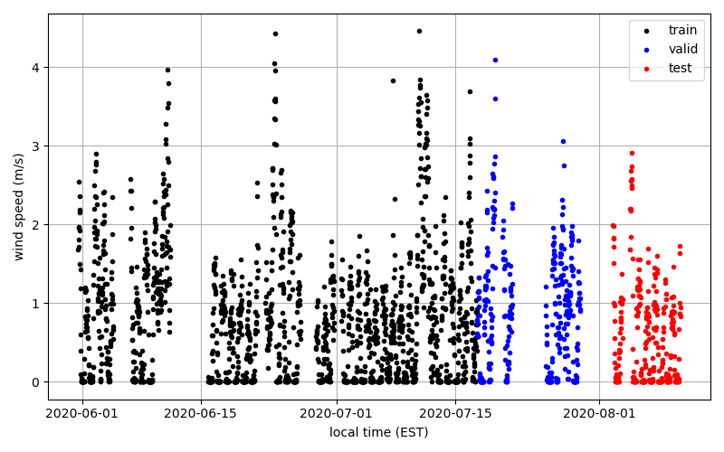
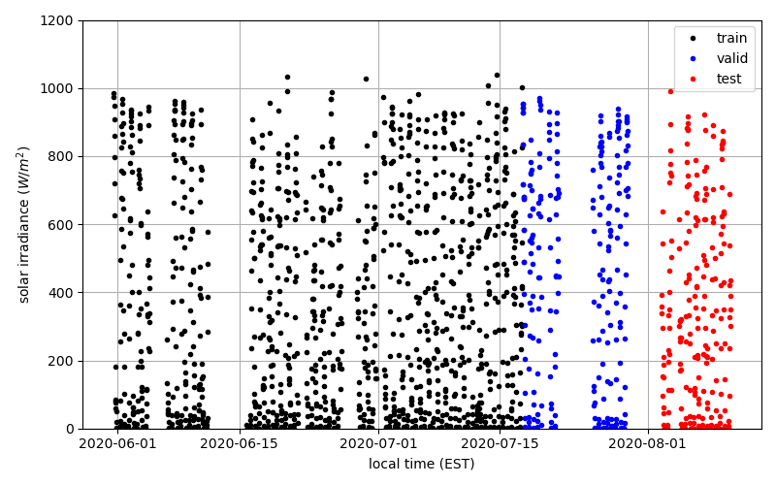
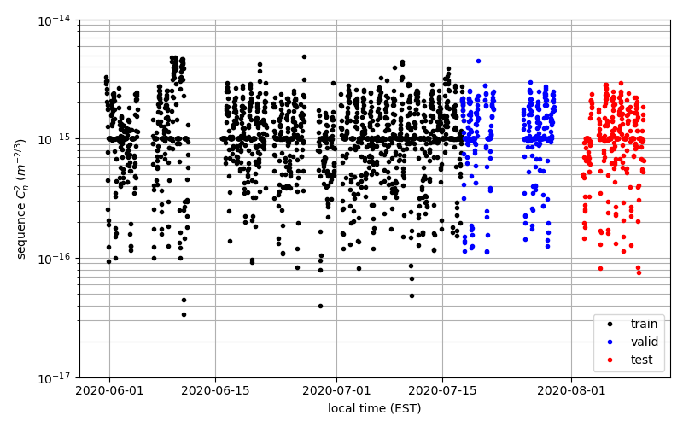
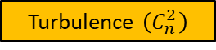
Sequence Plots
Temperature
Pressure
Relative Humidity
Wind Speed
Solar Irradiance
Turbulence $\left(C_{n}^{2}\right)$
Notes:
The sequence variables are plotted as function of time, and color coded on whether its train (black), validation (blue), or test (red) datasets. Note that temperature, relative humidity, solar irradiance, and turbulence look cyclic. Pressure has some long trends in the beginning but shorten in the validation / test days. Hard to make out cyclic nature or trends in wind speed. Because this is the input sequence of turbulence, the turbulence plot has a straight line at 10^-15 from nighttime filling. Temperature in test dataset is part of a cold snap which is not ideal, but is an inherent challenge of the problem.

Slide 23
Grid Search

Slide 24
The Grid Search
There are many combinations of model training parameters that can be adjusted, and each can impact performance
The grid search trains models using a defined parameter space
Each model is trained on the train dataset and evaluated on the validation dataset
In this thesis, 10 models are trained for each combination in the grid search space to ensure a robust result

Slide 25
Grid Search Parameters
Architecture / RNN Cell
MLP, simple RNN, LSTM-RNN, GRU-RNN
Input variables
Minimum of 4
Input sequence length
4, 8, 12, 16 hours
Number of hidden layers
1, 2
Number of nodes per hidden layer
10, 20, 30, 40, 50
Notes:
This is an overview slide of the grid search I performed. Briefly discuss the motivation of each. Architecture: important to know if an RNN is better for time series forecasting (it should be). Important to know if certain input variables are not important and introduce noise. Input sequence length is highly relevant to real-world applications. Number of hidden layers and nodes per hidden layer add depth and complexity to the model. Discuss that I trained 35,200 total models.

Slide 26
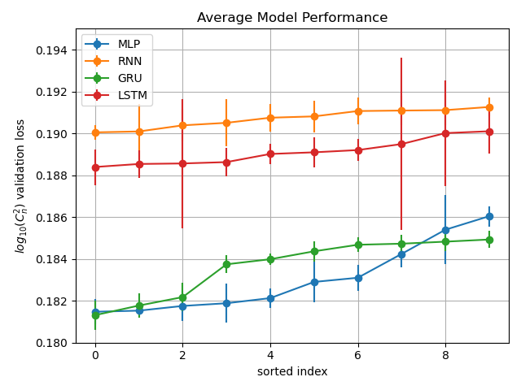
Grid Search Results
Average grid search results
Plot the best of each architecture
The GRU-RNN is the best performing overall
Notes:
Discuss how I made these plots and the trends in them.

Slide 27
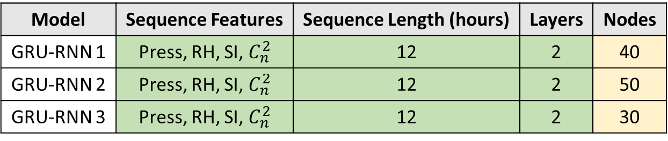
Best Results
The best 3 GRU-RNN models are highly consistent
Indicates the grid search has found a class of model parameters that is best
Model | Sequence Features | Sequence Length (hours) | Layers | Nodes
GRU-RNN 1 | Press, RH, SI, $C_{n}^{2}$ | 12 | 2 | 40
GRU-RNN 2 | Press, RH, SI, $C_{n}^{2}$ | 12 | 2 | 50
GRU-RNN 3 | Press, RH, SI, $C_{n}^{2}$ | 12 | 2 | 30
Selected model for further evaluation
Notes:
From the statistical significance, analyze the models that are above the dashed line in the last slide. Top table is the best 3 GRU-RNN models. Note that the sequence features, sequence length, and number of layers are all identical. Nodes range from 40-50-30 which is also as consistent as can be considering there are only 5 choices. This means the grid search has founded a “class” of models that are best for this problem. Similar result for MLP: all the same features, first 4 are the same sequence length, all the same layers, then the number of nodes varies.

Slide 28
Model Evaluation

Slide 29
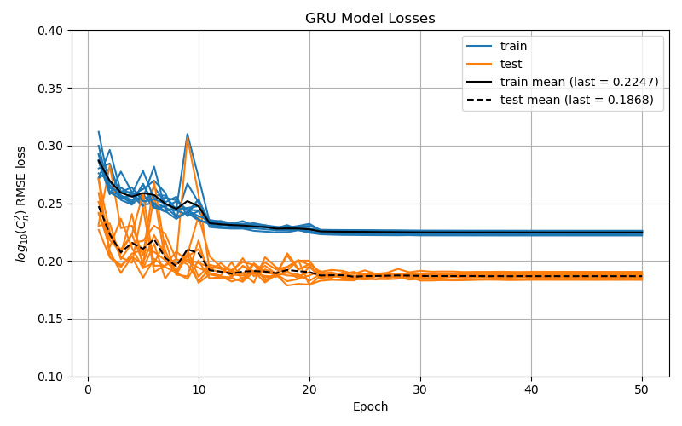
Ensemble Model Performance
Train 10 models of selected GRU-RNN
Plot model performance as a function of iterations through entire dataset
Loss curves illustrate convergence
Notes:
Discuss what this plot is and that it shows the model is converging to a strong solution every time

Slide 30
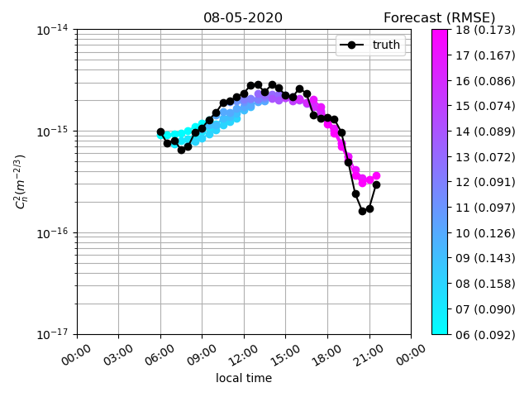
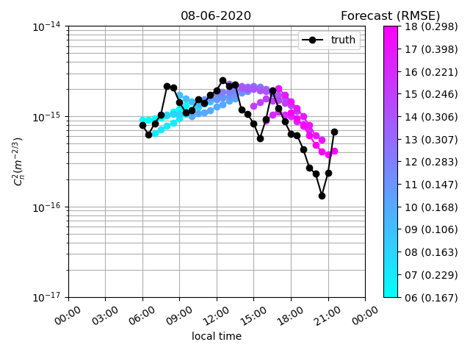
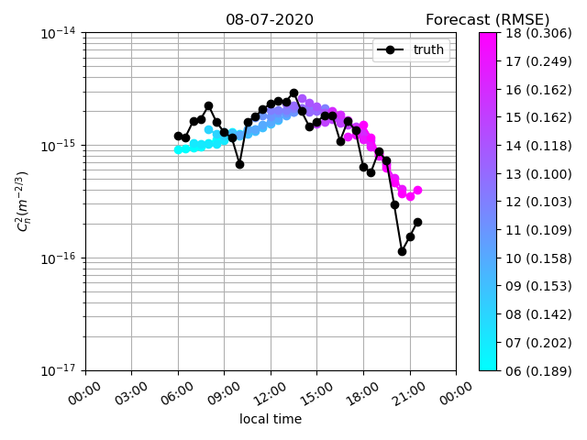
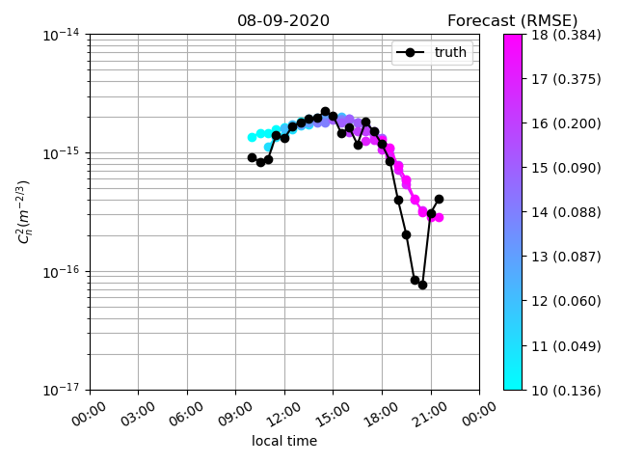
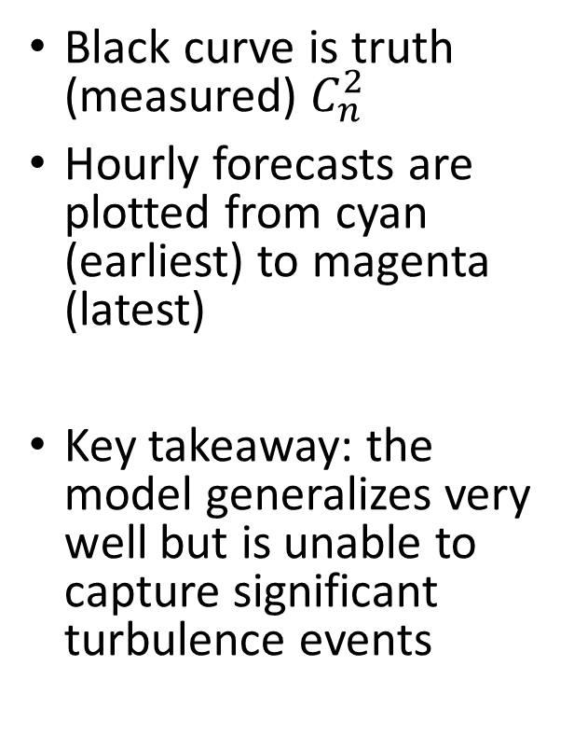
Daily Forecasts
Black curve is truth (measured) $C_{n}^{2}$
Hourly forecasts are plotted from cyan (earliest) to magenta (latest)
Key takeaway: the model generalizes very well but is unable to capture significant turbulence events
Notes:
First discuss what the plots are: turbulence as a function of local time for each test date. Black curve is truth, cyan to magenta are the forecasts. Point out that the model picks up on the general trends of turbulence but misses the weather events.

Slide 31
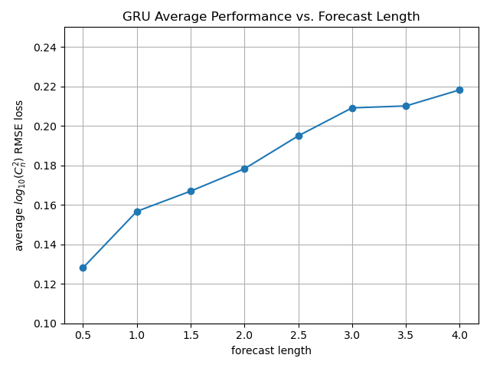
Forecast Length Performance
Calculate average error at each forecast time step
Result is expected trend:
Model performance degrades as forecast length increases
Notes:
Plot the loss score as a function of forecast length: it shows the expected trend that performance degrades as forecast length increases

Slide 32
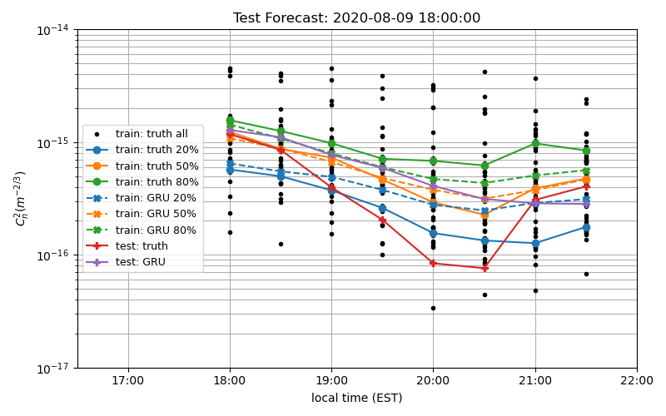
Individual Forecast Analysis: Poor Performance
Analyze 08/09 18:00 forecast
Train dataset 18:00 forecasts:
Calculate 20%, 50%, and 80% of measured turbulence strength at each time step
Calculate 20%, 50%, and 80% of modeled turbulence strength at each time step
Modeled conditions cannot reach the measured conditions
This evening turbulence condition is abnormally weak
Notes:
First discuss that this forecast is being analyzed to understand why the model performs so poorly. Discuss the general idea of this plot (using the bullets on the left of the slide). Essentially we see the model performs poorly because even when applied to the train dataset it cannot reach the high and low turbulence cases: i.e., it’s learned a very general forecast at 18:00, so when compared with a very out-of-character neutral event the model error score is bad.

Slide 33
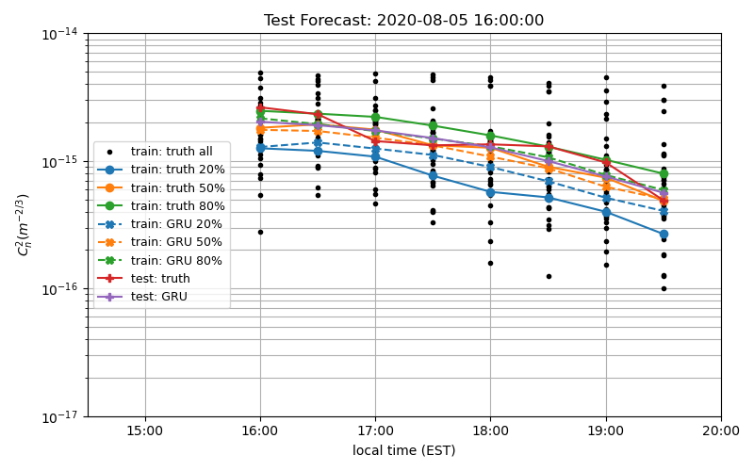
Individual Forecast Analysis: Good Performance
Analyze 08/05 16:00 forecast
Train dataset 16:00 forecasts:
Calculate 20%, 50%, and 80% of measured turbulence strength at each time step
Calculate 20%, 50%, and 80% of modeled turbulence strength at each time step
Modeled conditions cannot reach the measured conditions
This evening turbulence condition is representative of the train examples
Notes:
Analyze this test forecast because the model performs very well. It’s shown to perform very well because the truth measurements are well within the bounds of the model’s capability, so it captures it well.

Slide 34
Contributions
Illustrated that artificial neural networks are capable of forecasting future turbulence conditions from prior environmental parameters
The model generalizes very well
First use of the recurrent neural network for turbulence modeling
Found the GRU-RNN as the best RNN Cell
Notes:
These are the major contributions of this work.

Slide 35
Future Work
Apply this technique to a different (and bigger) dataset
Improve data preprocessing techniques
Employ an RNN as the output of the model
Notes:
Just elaborate on this parsed-down list of future work items. Improved preprocessing techniques includes better nighttime filling, interpolating missing data points to preserve more examples. Shorter and longer forecasts each have their utility. RNN as the output forces the model to learn the temporal nature of the outputs.

Slide 36
Acknowledgements
Dr. Edward Watson
Colleagues at MZA Associates Corporation
Dr. Matthew Whiteley
Dr. Yakov Diskin
Dr. Jason Schmidt
Parents

Slide 37
Backup

Slide 38
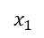
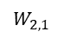
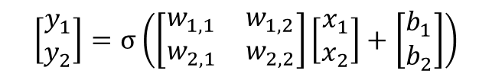
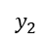
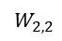

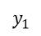
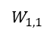

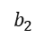
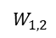



Multilayer Perceptron (MLP)
Two layers of an MLP are fully connected by matrix math
First Layer
$$b_{1}$$
Second Layer
$$x_{1}$$
$$W_{1, 1}$$
$$y_{1}$$
$$\vec{y}=σ\left(W\vec{x}+\vec{b}\right)$$
$$W_{1, 2}$$
$$\left[\begin{matrix}y_{1} \\ y_{2}\end{matrix}\right]=σ\left(\left[\begin{matrix}w_{1, 1} & w_{1, 2} \\ w_{2, 1} & w_{2, 2}\end{matrix}\right]\left[\begin{matrix}x_{1} \\ x_{2}\end{matrix}\right]+\left[\begin{matrix}b_{1} \\ b_{2}\end{matrix}\right]\right)$$
$$W_{2, 1}$$
$$W_{2, 2}$$
$$x_{2}$$
$$y_{2}$$
$$y_{1}=σ\left(w_{1, 1}x_{1}+ w_{1, 2}x_{2}+b_{1}\right)$$
$$b_{2}$$
$$y_{2}=σ\left(w_{2, 1}x_{1}+ w_{2, 2}x_{2}+b_{2}\right)$$
Notes:
Go over the process that an MLP uses to fully-connect its layers. This might be too detailed and would be better as backup.

Slide 39

Multilayer RNN for Turbulence Forecasting
Inputs are processed as a time series
Outputs are eight time steps of turbulence forecasts
Three variants of the RNN cell are investigated:
simple RNN
LSTM-RNN
GRU-RNN
Initial hidden state is zero
Initial hidden state is zero
Notes:
This is a multi-layer RNN. Be sure to note how the hidden state at each time step of the first layer is the input at each time step of the second layer. The second layer final hidden state h_{t}^{2} is fully-connected to the output layer. The hidden state of each layer is initialized with zeros. The additional depth of the multi-layer RNN allows the network to learn more complex representations.

Slide 40



Sigmoid squishes values between 0 and 1
Tanh squishes values between -1 and +1
ReLU sets negative numbers to 0 but does nothing to positive numbers
Notes:
These are the nonlinear activation functions used throughout this work. The MLP is set to use ReLU. The RNNs use the Sigmoid and Tanh by default.

Slide 41
RNN Cell Variants
The Simple (original) RNN
This updates the hidden state by a single equation and is prone to vanishing and exploding gradients.
The Long Short-Term Memory RNN (LSTM-RNN)
This updates the hidden state by the use of a cell state passed over time that acts as memory. Four gates add and remove information.
The Gated Recurrent Unit RNN (GRU-RNN)
Motivated by the LSTM but does not use a cell state. It is more general by applying updates to the hidden state with three gates.
Notes:
Discuss the three RNN Cell variants. The details of each Cell are in backup slides.

Slide 42
Simple RNN
The simple RNN updates the hidden state at each time step by:
The simple RNN struggles to capture long-term dependencies because the rate of change of its parameters (the gradients) tend to vanish or explode
Learnable Parameters
$${\vec{h}}_{t}=\tanh\left(W_{ih}{\vec{x}}_{t}+{\vec{b}}_{ih}+W_{hh}{\vec{h}}_{\left(t−1\right)}+{\vec{b}}_{hh}\right)$$
Inputs at time t
Hidden state at time t-1

Slide 43
LSTM-RNN
The Long Short-Term Memory RNN deals with the vanishing/exploding gradients problem with a new cell architecture and learning algorithm
The LSTM-RNN processes a cell state at each time step
Four gates add or remove information to the cell state
The cell state updates the hidden state at each time step

Slide 44

LSTM-RNN
$${\vec{f}}_{t}=σ\left(W_{if}{\vec{x}}_{t}+{\vec{b}}_{if}+W_{hf}{\vec{h}}_{\left(t−1\right)}+{\vec{b}}_{hf}\right)$$
$${\vec{g}}_{t}=\tanh\left(W_{ig}{\vec{x}}_{t}+{\vec{b}}_{ig}+W_{hg}{\vec{h}}_{\left(t−1\right)}+{\vec{b}}_{hg}\right)$$
$${\vec{i}}_{t}=σ\left(W_{ii}{\vec{x}}_{t}+{\vec{b}}_{ii}+W_{hi}{\vec{h}}_{\left(t−1\right)}+{\vec{b}}_{hi}\right)$$
$${\vec{C}}_{t}={\vec{f}}_{t} ⨀{ \vec{C}}_{\left(t−1\right)}+{\vec{i}}_{t} ⨀{ \vec{g}}_{t}$$
$${\vec{o}}_{t}=σ\left(W_{io}{\vec{x}}_{t}+{\vec{b}}_{io}+W_{ho}{\vec{h}}_{\left(t−1\right)}+{\vec{b}}_{ho}\right)$$
$${\vec{h}}_{t}={\vec{o}}_{t} ⨀\tanh\left({\vec{C}}_{t}\right)$$
Forget gate determines how much to forget from the prior cell state
Cell gate calculates new candidate node values
Input gate determines how much of the candidate values to input to the new cell state
Cell state updates by applying the forget gate to the prior cell state and adding the candidate values passed through the input gate
Output gate determines how much to update the hidden state
Hidden state applies output gate to cell state

Slide 45
GRU-RNN
The Gated Recurrent Unit RNN is motivated by the LSTM-RNN but is much simpler to compute and implement
The GRU-RNN does not use a cell state like the LSTM-RNN
The GRU-RNN applies updates to only the hidden state with three gates that are more general

Slide 46

GRU-RNN
The reset gate determines how much of the previous hidden state is relevant in the update of the hidden state
$${\vec{r}}_{t}=σ\left(W_{ir}{\vec{x}}_{t}+{\vec{b}}_{ir}+W_{hr}{\vec{h}}_{\left(t−1\right)}+{\vec{b}}_{hr}\right)$$
$${\vec{z}}_{t}=σ\left(W_{iz}{\vec{x}}_{t}+{\vec{b}}_{iz}+W_{hz}{\vec{h}}_{\left(t−1\right)}+{\vec{b}}_{hz}\right)$$
$${\vec{n}}_{t}=\tanh\left(W_{in}{\vec{x}}_{t}+{\vec{b}}_{in}+{\vec{r}}_{t}⨀\left(W_{hn}{\vec{h}}_{\left(t−1\right)}+{\vec{b}}_{hn}\right)\right)$$
$${\vec{h}}_{t}=\left(1−{\vec{z}}_{t}\right) ⨀{ \vec{n}}_{t}+{\vec{z}}_{t} ⨀{ \vec{h}}_{\left(t−1\right)}$$
The update gate controls how much information from the previous hidden state caries to the current hidden state.
The new gate calculates the proposed new hidden state
Hidden state applies output gate to cell state

Slide 47

Gradient Descent
Gradient descent is the algorithm that updates the model’s parameters
The algorithm makes incremental steps to minimize the error between model output and truth
Notes:
Example of gradient descent incrementally updating the learnable parameters to find the minimum error.

Slide 48

Gradient Descent
Example illustration of gradient descent for a complicated model
The algorithm incrementally steps to find the global minimum of the loss function
Notes:
Example of gradient descent for a complicated model

Slide 49


Turbulence Sensor
The DELTA is a profiler that measures turbulence along the propagation path
Calculates differential jitter of feature pairs as a function of angular separation
Measurements are uniform-path averaged
Notes:
Do I need this slide? This one is easy to chop off if I need to remove slides for time. Discuss how the DELTA is a turbulence profiler by calculating differential jitter as a function of angular separation. Measurements are uniform-path averaged for this work.

Slide 50







Probability Density Plots
Validation dataset measurements beyond the dynamic range of the train dataset
Temperature
Pressure
Relative Humidity
Wind Speed
Solar Irradiance
Turbulence $\left(C_{n}^{2}\right)$
Notes:
Note that these are probability distribution functions and represent the probability that a value of the variable would be each bin in the distribution. Three distributions are shown for train / validation / and test sets. Note how the temperature validation data is higher than anything in training and testing dataset. This is not ideal but because the train and validation sets are combined, this slight issue will not propagate to the test results. Pressure does not look great, but it’s okay. Relative humidity, wind speed, solar irradiance, and turbulence distributions look really good. The spike around -15 in the turbulence plot is due to the nighttime filling.

Slide 51

Turbulence Forecast Plots
Very weak measurements of turbulence are neutral events
Validation / test datasets are within the dynamic range of the train dataset
Notes:
These are the temporal and probability density plots for the forecast data. Note that it’s again split into train, validation, and test datasets. Also note that the abundance of values at 1e-15 are missing because we’re not forecasting during the nighttime, so the nighttime filling isn’t here. Note that the distributions of the three datasets look really good, and the validation and test sets are within the dynamic range of the train dataset. Also note here that the really weak measurements of turbulence are morning and evening neutral events when the atmosphere calms down due to equilibrium of weather conditions and turbulence falls really weak.

Slide 52
Grid Search Motivation
There are many combinations of model training parameters that can be adjusted, and each can impact performance
Example model training parameters:
Parameter | Description
optimization algorithm | how the model minimizes its loss function
learning rate | step size taken by optimization algorithm
number of layers & nodes in architecture | size and structure of the model
Notes:
Introduce the grid search and example training parameters that can be optimized.

Slide 53

Grid Search Description
The grid search trains models using a defined parameter space
Each model is trained on the train dataset and evaluated on the validation dataset
Model performance is evaluated with RMSE (root mean square error)
$RMSE=\sqrt{\frac{1}{N}\sum_{n=1}^{N}{{\left(x_{n}−y_{n}\right)}^{2}}}$
In this thesis, 10 models are trained for each combination in the grid search space to ensure a robust result
Notes:
Further introduce the grid search and how performance is based on the validation dataset with RMSE, and that 10 models are trained for each combination to ensure stability.

Slide 54
Grid Search Parameters
contribution to total combinations
Architecture / RNN Cell
MLP, simple RNN, LSTM-RNN, GRU-RNN
Input variables
Minimum of 4
Input sequence length
4, 8, 12, 16 hours
Number of hidden layers
1, 2
Number of nodes per hidden layer
10, 20, 30, 40, 50
4
multiply = 3,520
22
multiply by 10 for 10 models per combination
4
2
35,200 total models trained
5
Notes:
This is an overview slide of the grid search I performed. Briefly discuss the motivation of each. Architecture: important to know if an RNN is better for time series forecasting (it should be). Important to know if certain input variables are not important and introduce noise. Input sequence length is highly relevant to real-world applications. Number of hidden layers and nodes per hidden layer add depth and complexity to the model. Discuss that I trained 35,200 total models.

Slide 55

Grid Search Results
Average the validation loss scores over the 10 models for each grid search iteration, and calculate the standard error
Sort the results from best to worst
The GRU-RNN is the best performing overall, but as a whole the MLP is doing quite well
Notes:
Discuss how I made these plots and the trends in them.

Slide 56

Statistical Significance
The Student’s t-test tests the significance of a difference of means
The 10-model loss scores are the measurements
The change in model training combination is the “event” between samples
Compare the average of the best performing GRU-RNN
Anything below the dashed line is statistically worse than the best GRU-RNN model
Notes:
Explain that the Student’s t-test is a statistical significance test for two means. It’s simply used as a support for model selection. The test is performed for the best models against the very best GRU-RNN model. Anything below the dashed line is statistically worse. The two red points around / above the dashed line are explained by the very large standard error in the last slide.

Slide 57


Best Results
The best 3 GRU-RNN models are highly consistent
The best 7 MLP models are consistent
GRU-RNN uses $C_{n}^{2}$ as an input, but MLP does not
GRU-RNN uses 12 hours, best MLPs use 16 hours of input sequence length
Model | Sequence Features | Sequence Length (hours) | Layers | Nodes
GRU-RNN 1 | Press, RH, SI, $C_{n}^{2}$ | 12 | 2 | 40
GRU-RNN 2 | Press, RH, SI, $C_{n}^{2}$ | 12 | 2 | 50
GRU-RNN 3 | Press, RH, SI, $C_{n}^{2}$ | 12 | 2 | 30
Model | Sequence Features | Sequence Length (hours) | Layers | Nodes
MLP 1 | Temp, Press, RH, SI | 16 | 2 | 30
MLP 2 | Temp, Press, RH, SI | 16 | 2 | 40
MLP 3 | Temp, Press, RH, SI | 16 | 2 | 50
MLP 4 | Temp, Press, RH, SI | 16 | 2 | 20
MLP 5 | Temp, Press, RH, SI | 12 | 2 | 40
MLP 6 | Temp, Press, RH, SI | 12 | 2 | 30
MLP 7 | Temp, Press, RH, SI | 12 | 2 | 50
Notes:
From the statistical significance, analyze the models that are above the dashed line in the last slide. Top table is the best 3 GRU-RNN models. Note that the sequence features, sequence length, and number of layers are all identical. Nodes range from 40-50-30 which is also as consistent as can be considering there are only 5 choices. This means the grid search has founded a “class” of models that are best for this problem. Similar result for MLP: all the same features, first 4 are the same sequence length, all the same layers, then the number of nodes varies.

Slide 58

Model Selection
Model selected for testing:
Architecture: GRU-RNN
Layers: 2
Nodes per layer: 40
Input sequence length: 12 hours
Input sequence variables: pressure, relative humidity, solar irradiance, $C_{n}^{2}$
Motivation:
Results in the lowest average RMSE as applied to the validation dataset
Next best two models use the same input feature, sequence length, and number of layers. The next two models use similar number of nodes.
Model requires 12 hours of input sequence
Notes:
I pick the best GRU-RNN model from the grid search. List it’s training parameters. Discuss briefly the motivation for using it.

Slide 59



Sensitivity Analysis
Best Models
Count the number of times each variable is used in the best 10% and worst 10% models
Relative humidity and solar irradiance: always used in the best, and rarely used in the worst
Wind speed: never used in the best, always used in the worst
$C_{n}^{2}$: frequently used by the best RNNs, less used by the best MLPs
Indicates the RNNs are learning the physical component of data propagating through time
Worst Models
Notes:
Discuss the trends from this sensitivity analysis. First, relative humidity and solar irradiance are key drivers. Wind speed is shown to be useless. The RNNs are better at picking up on the use of prior Cn2, which is expected to be the best. This is encouraging that the RNNs are learning the physical nature of time evolution, but the MLP is not (since it has no time processing aspect)

Slide 60

Daily Performance Summary
Evaluate model performance on a per-day basis
Calculate the 10-model average, standard deviation, minimum and maximum of the loss scores
Tight bounds about the mean indicate the model is consistently converging to the same solution
Notes:
Explain what this plot is, and that is shows model performance is consistent across multiple trained models, but is quite variable comparing performance on one day vs. another

Slide 61

Hourly Performance Summary
Plot the loss score of each forecast as a function of its first timestamp
Black markers are the raw scores (of all 10 models)
Red markers are the average over the 10 models
Trend: the model is best during the middle of the day, and worst in the evening
Notes:
Discuss the idea of this plot and that the trend indicates model performance is generally very good during the middle of the day, then poor in the evening.

Slide 62








Scatter Plots
30-minute
1 hour
1.5 hours
2 hours
2.5 hours
3 hours
3.5 hours
4 hours
Notes:
For all of the test dataset performance, plot forecasted Cn2 vs. measured Cn2 for each forecast timestamp (30 minutes, 1 hour, … 3.5 hours, 4 hours). This can easily be put into backup slides and instead just show the plot that summarizes the RMSE scores

Slide 63
Individual Forecast Analysis: Poor Performance
Analyze 08/09/2020 18:00 forecast
Sort all measurements from train examples whose forecast is at 18:00
Calculate the cumulative distribution function (CDF) at each timestamp
Apply model to the train examples at 18:00, and perform same sorting and CDF
Even on train dataset, model is bounded on its outputs
This evening neutral event is abnormally strong so it’s expected the model misses
Notes:
First discuss that this forecast is being analyzed to understand why the model performs so poorly. Discuss the general idea of this plot (using the bullets on the left of the slide). Essentially we see the model performs poorly because even when applied to the train dataset it cannot reach the high and low turbulence cases: i.e., it’s learned a very general forecast at 18:00, so when compared with a very out-of-character neutral event the model error score is bad.

Slide 64

Individual Forecast Analysis 2
Analyze 08/06/2020 14:00 forecast
Sort all measurements from train examples whose forecast is at 14:00
Calculate the cumulative distribution function (CDF) at each timestamp
Apply model to the train examples, and perform same sorting and CDF
Even on train dataset, model is bounded on its outputs
This middle-of-day turbulence is highly abnormal, so it’s expected the model misses
Notes:
This forecast is analyzed because it is in the middle of the day where performance is generally good. Again we see the model is bounded to be very narrow, so this highly weather-impacted turbulence event is not captured because the model can’t capture this even when applied to the train dataset.

Slide 65
Individual Forecast Analysis: Good Performance
Analyze 08/05/2020 16:00 forecast
Sort all measurements from train examples whose forecast is at 16:00
Calculate the cumulative distribution function (CDF) at each timestamp
Apply model to the train examples at 16:00, and perform same sorting and CDF
Model performance on test set is good here because the test conditions are within the bounds of what the model has learned to predict
Notes:
Analyze this test forecast because the model performs very well. It’s shown to perform very well because the truth measurements are well within the bounds of the model’s capability, so it captures it well.

Slide 66
Presentation Tips

Slide 67
How to Speak by Patrick Winston
How to start
Empowerment Promise
Tell them what they’re going to know at the end of the talk
Their reason for being here
Build a fence around my idea so it is distinguished from other ideas
My idea forecasts turbulence from prior environmental parameters
Slides are for exposing ideas, not teaching ideas

Slide 68
Important rules for slides
Do not read
Keep images simple
Eliminate clutter (eliminate bullets?)
Leave air in the slides
Provide a promise up from and exhibit passion: this can be inspiring

Slide 69
How to end your slides
Final slide is labeled “contributions”
Argued uniqueness of human intelligence
Demonstrated culturally biased understanding, persuasive retelling, schizophrenic behavior, and self-aware machines
Offered steps toward a better understanding of ourselves
Let people read this slide!
How to let people know you’re finished
Salute the audience
Hand it back to advisor

Slide 70
This is 10 point Calibri
This is 15 point Calibri
This is 20 point Calibri
This is 25 point Calibri
This is 30 point Calibri
This is 35 point Calibri
This is 40 point Calibri
This is 50 point Calibri

